Slide 1

PHOTOGRAPHY LABS
TEAM:
PRANAV SAGGAM-700739822
SACHIN BENIWAL -700741814

Slide 2

INTRODUCTION:
Our application deals with and controls how the photographer is hired for the particular occasion. Additionally, it controls how the customer's request and response are handled dependent on the photographer's and the event's bandwidth. By doing this, the customer receives the desired service of event they require.

Slide 3
Technologies used:
Front-End Technologies: Html ,CSS ,Bootstrap ,JavaScript, jQuery.
Back-End Technologies: MySQL , Php.

Slide 4

Objective:
Sign up page for user to register for website.
Sign in page for user to login to the website
After login user can view home page.
A Contact page for the user to contact.
A About page for the user to know about the website.
A page for guest users to book the event.
A user profile for the user to update the details.
A dashboard page for admin to see all the statistics.

Slide 5
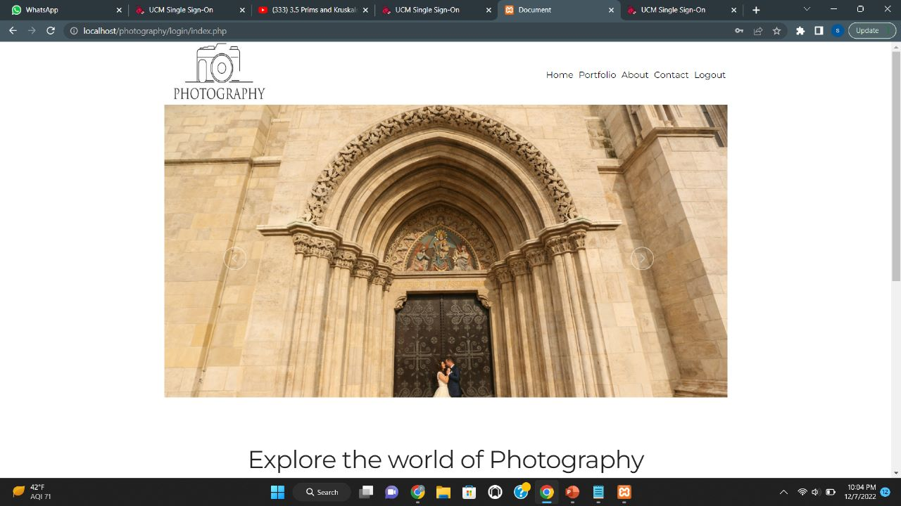
Home page:

Slide 6
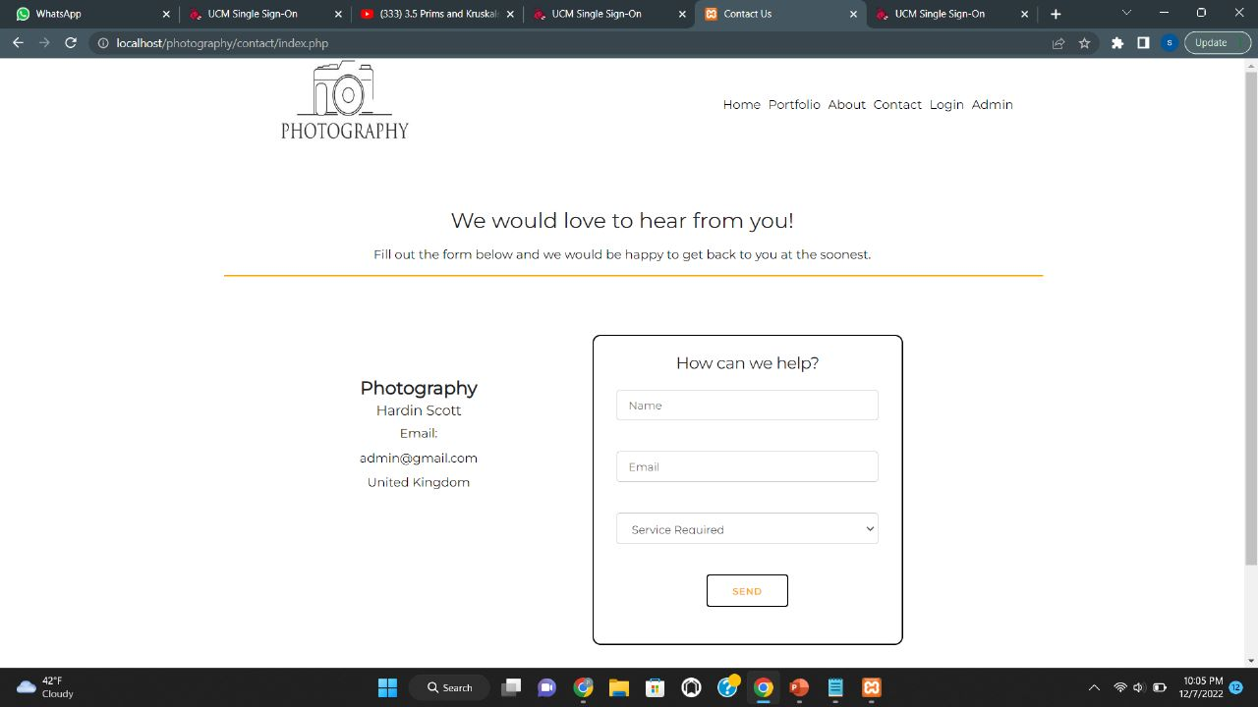
contact page:
.

Slide 7
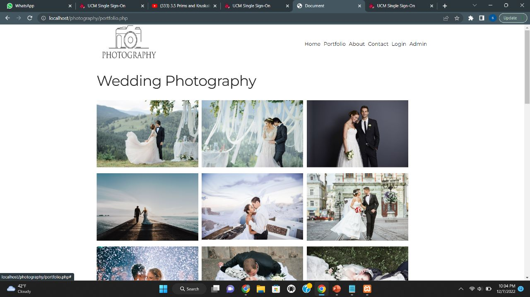
PORTFOLIO PAGE:

Slide 8
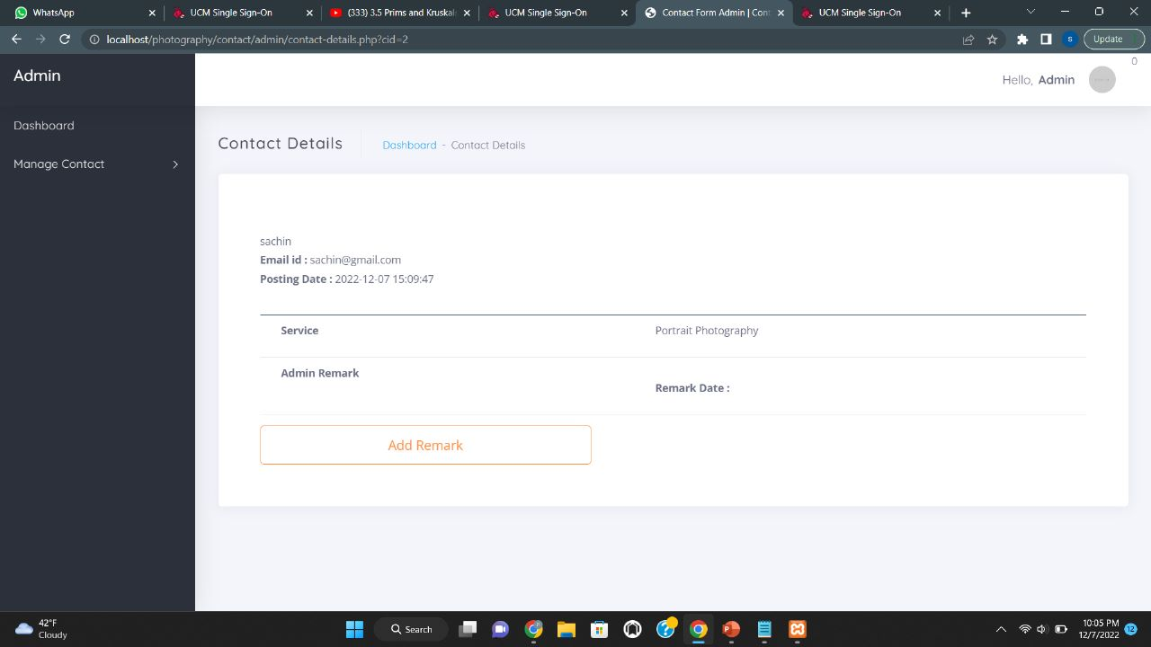
ADMIN DASHBOARD:
.

Slide 9
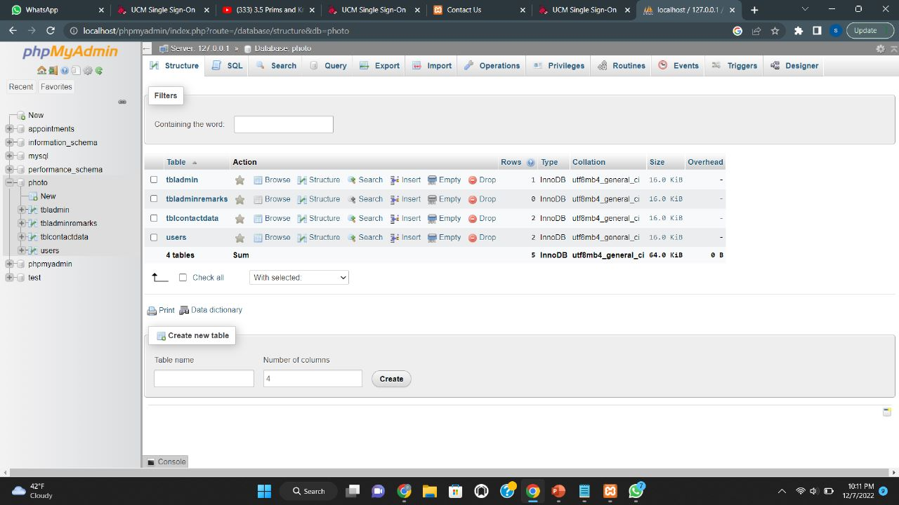
DATABASE TABLES:

Slide 10
THANK YOU
.

